Slide 1
AI-Assisted Game Mashups
By: Zidian, Jackie, B

Slide 2
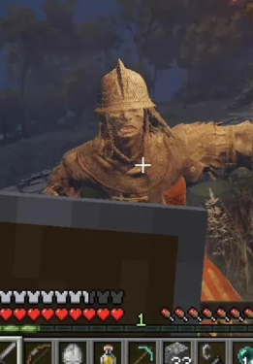
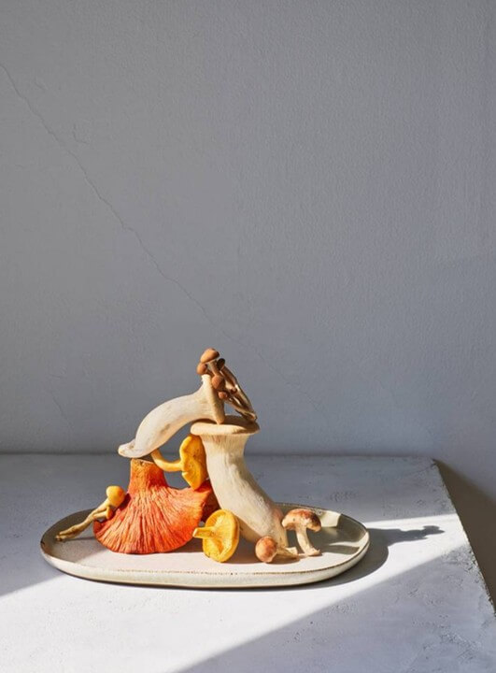
What Is a Game Mashup?
A game mashup combines elements, gameplay from two different games, allowing player using one's mechanic in another.

Slide 3
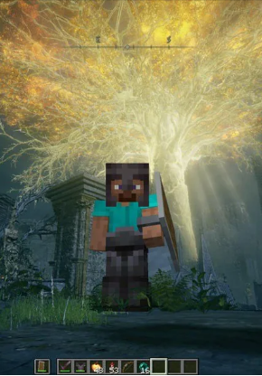
Example: Minecraft & Elden Ring
This was very popluar recently when Quince uploaded his video about Steve in Elden Ring. Even tho he didnt really mentioned how he exacly mashed two game, but using claude ai to merge games is popluar recently, and due to all of stuff he added to Elden Ring, we assumed he used claude to help his creation.

